Slide 1


Data Analysis with Microsoft Excel

Slide 2





PivotTable
Lecture 3: Output
Pivot Charts
www.dsa.az Bütün hüquqlar qorunur.
DATA SCIENCE ACADEMY
2

Slide 3


PivotTable

Slide 4
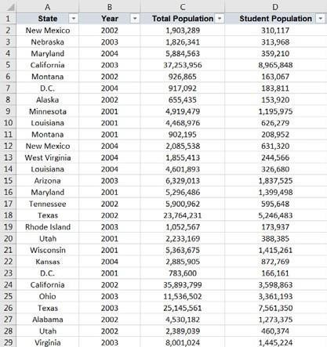

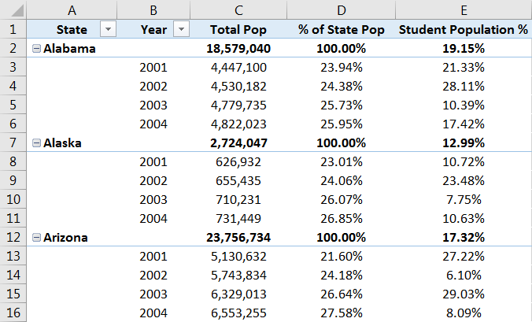
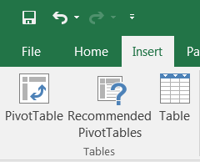
Why Pivot Table?
PivotTables allow you to easily organize, filter, summarize, and analyze raw data.
www.dsa.az Bütün hüquqlar qorunur.
DATA SCIENCE ACADEMY
4

Slide 5
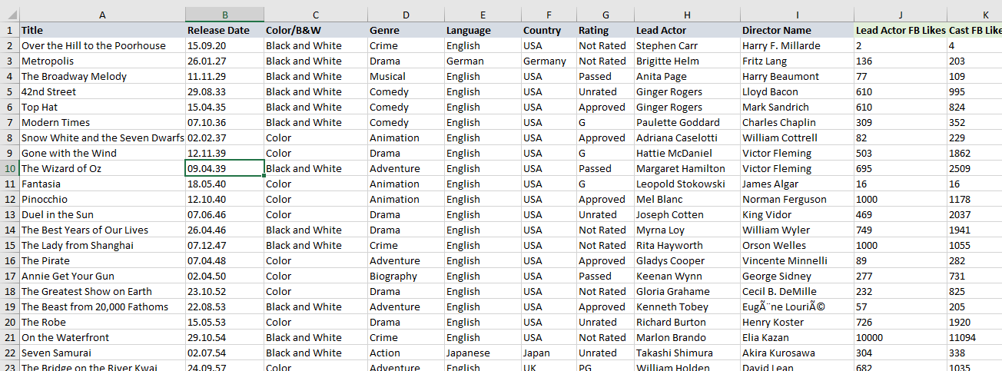

Pivot Table – Data Structure
Columnar data (titles on columns)
No empty column name
No extra headers, footers, subtotals or calculated fields
No header in rows
www.dsa.az Bütün hüquqlar qorunur.
DATA SCIENCE ACADEMY
5

Slide 6
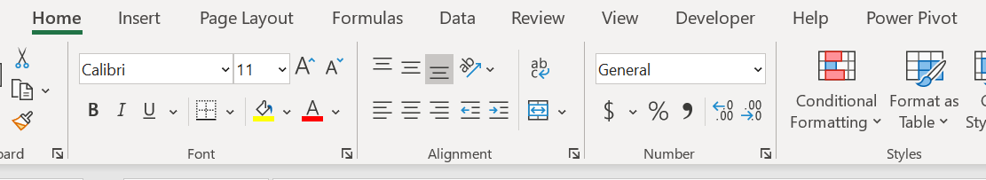
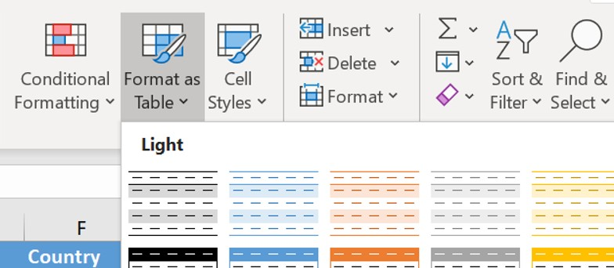
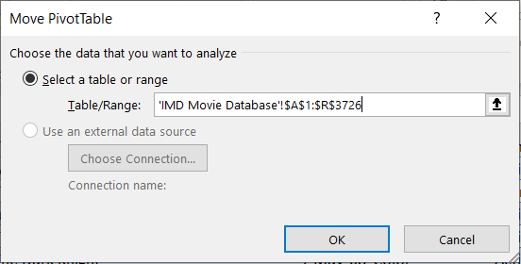
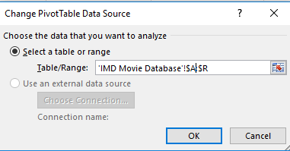

Pivot table – Dealing with Growing Data Source
Format the source data as a table (table can be named and referenced)
Select your table data, go to Home>Format as table, choose anyone
Remove row number from the data source (in or example $A:$R)
www.dsa.az Bütün hüquqlar qorunur.
DATA SCIENCE ACADEMY
6

Slide 7

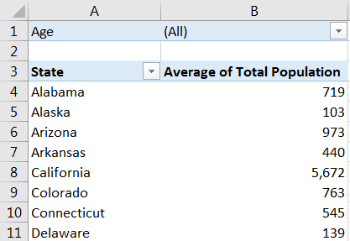

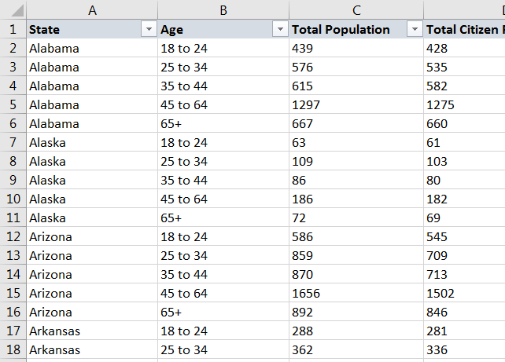



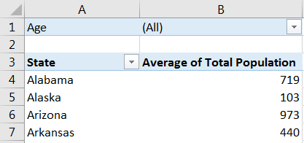

How Do Pivots Actually Work?
STEP 1: Detect/evaluate coordinates
State = Arizona
Measure = Total Population
Filter = All ages
Excel isolates relevant source data
STEP 2: Apply arithmetic
Summarize Values By: AVERAGE
(vs. SUM, COUNT, MAX, MIN, etc.)
NOTE: You can doubleclick any specific value in a Pivot to generate a new tab showing the exact source data used to calculate it
STEP 3: Display result
(586+859+870+1656+892)/5 = 973
www.dsa.az Bütün hüquqlar qorunur.
DATA SCIENCE ACADEMY
7

Slide 8


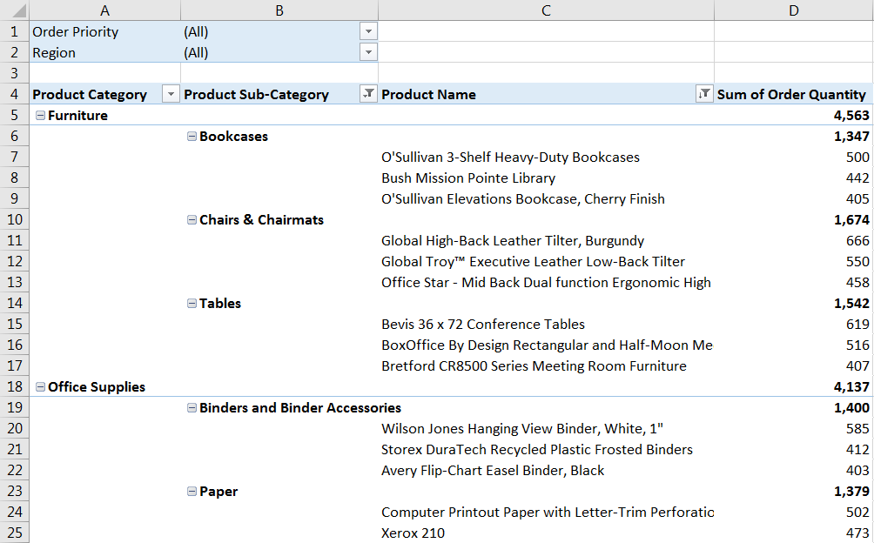
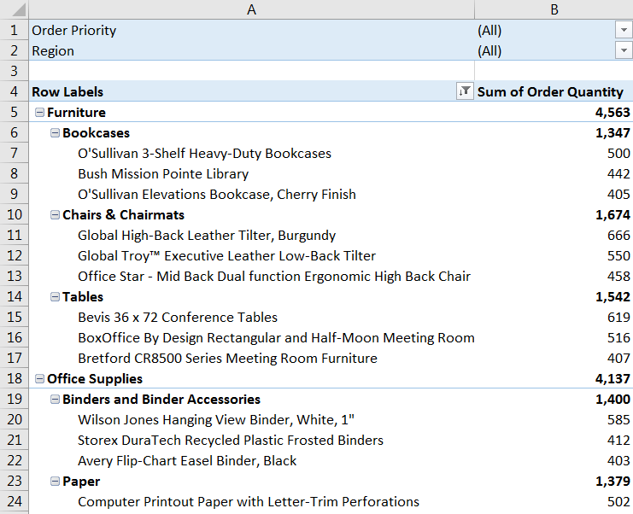
Table Layouts: COMPACT vs. OUTLINE
Compact Form (default): Outline Form (recommended):
Nested fields/dimensions condensed into one column, with one filter option
Each field/dimension broken out into its own column, with separate column headers and filter options
Allows you to apply custom filters to each field (i.e. label filters on the Product Category field and value filters on the Product SubCategory field)
www.dsa.az Bütün hüquqlar qorunur.
DATA SCIENCE ACADEMY
8

Slide 9
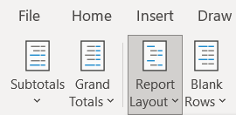


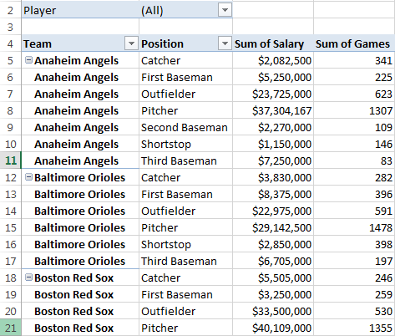
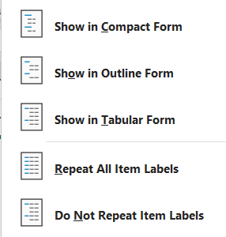
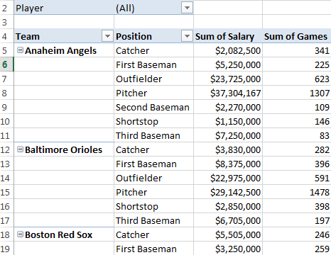
Table Layouts: TABULAR
Tabular Form (nonrepeating):
Tabular Form (repeating):
www.dsa.az Bütün hüquqlar qorunur.
DATA SCIENCE ACADEMY
9

Slide 10


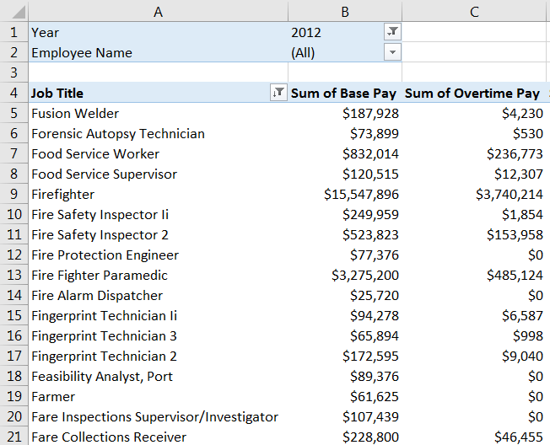
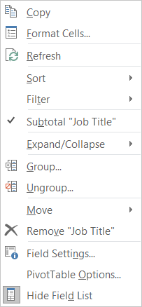
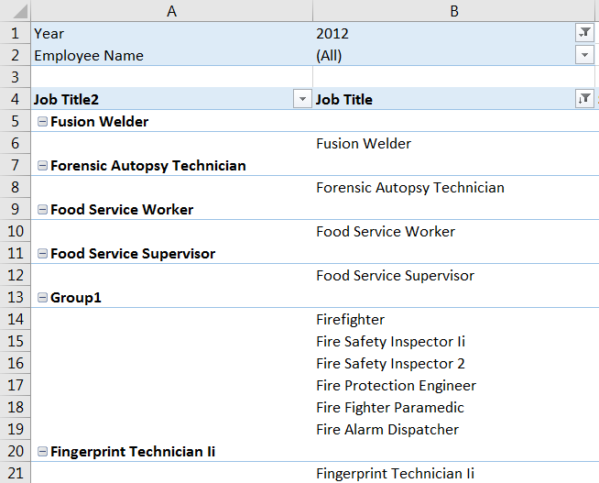
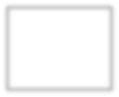


GROUPING DATA
Select values that you’d like to group
(in this case firerelated job titles)
Rightclick and select Group
A new field is created (“Job Title2“) containing the new group (“Group1“)
Note: Both names can be customized
www.dsa.az Bütün hüquqlar qorunur.
DATA SCIENCE ACADEMY
10

Slide 11

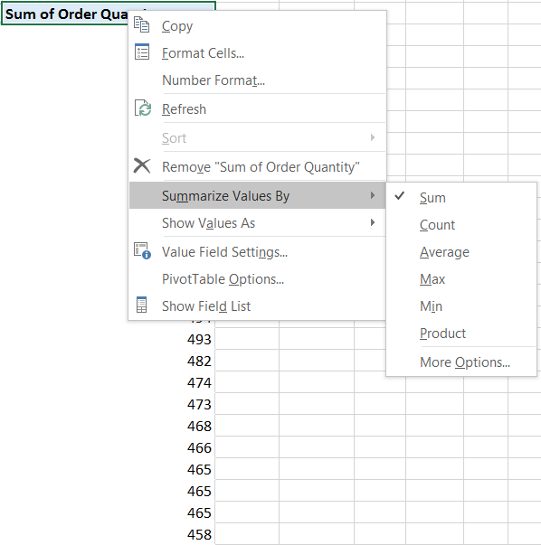



Summarize by values
Summarize Values By determines how numbers should be treated when they are rolled up or aggregated (sum, count, average, max, etc.)
www.dsa.az Bütün hüquqlar qorunur.
DATA SCIENCE ACADEMY
11

Slide 12

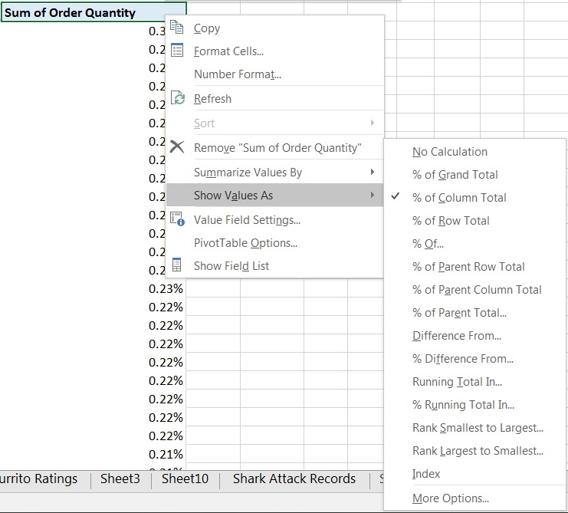




Show as values
Show Values As options allow you to apply additional calculations to change the way values are shown, such as the Percent of a Total or Subtotal, Running Value, Rank, etc.
`
In this case, we’re showing Order Quantity values as % of Column Total, rather than whole numbers
www.dsa.az Bütün hüquqlar qorunur.
DATA SCIENCE ACADEMY
12

Slide 13


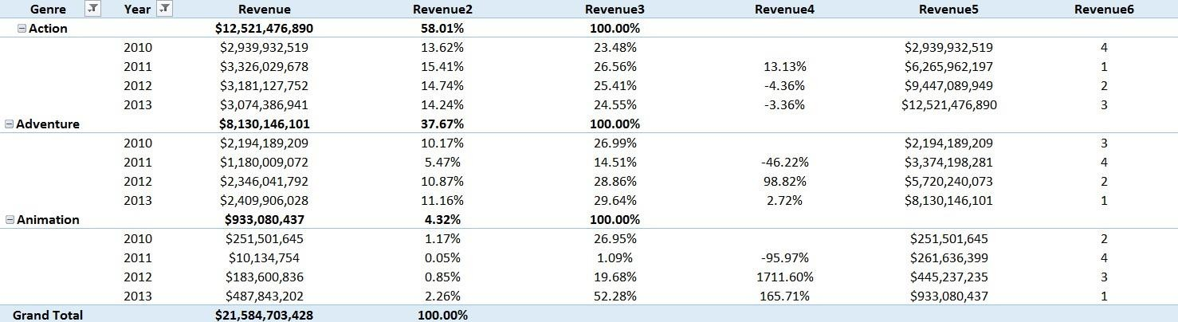
Show as values
In this example we’re summarizing the same Revenue field 6 different ways:
Value
(no calculation)
% of Total
Column
% of Parent
(genre)
% Difference
(prev. year)
Running Total
(by year)
Rank
(Large →Small)
www.dsa.az Bütün hüquqlar qorunur.
DATA SCIENCE ACADEMY
13

Slide 14


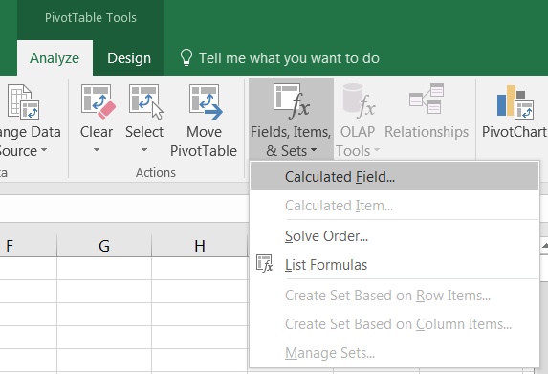
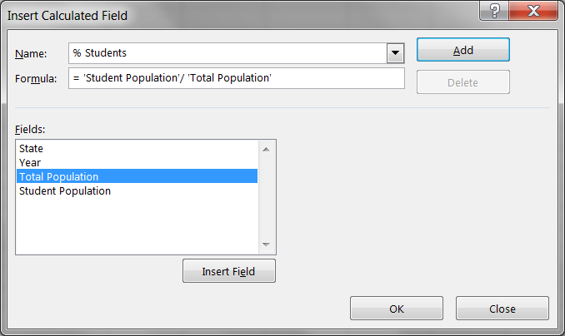


Calculated Fields
Calculated Fields allow you to create new measures based on existing, numerical fields:
www.dsa.az Bütün hüquqlar qorunur.
DATA SCIENCE ACADEMY
14

Slide 15
Pivot Chart

Slide 16

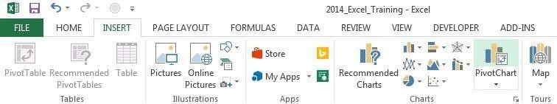




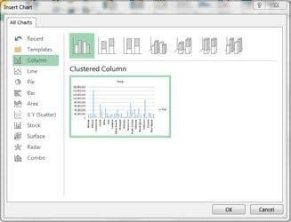
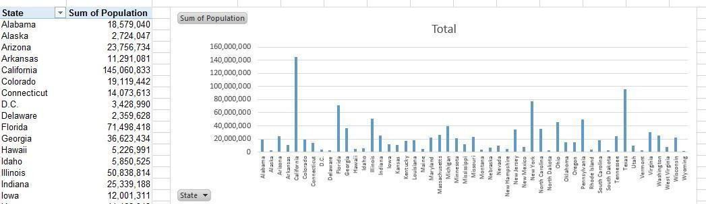

Pivot Chart
A PivotChart is simply a chart that is tied to a specific PivotTable; as you adjust filters and
fields in your Pivot, the PivotChart updates dynamically
1) Select your pivot and choose PivotChart from either the “Insert” tab or the “Analyze” tab
2) Select a chart type
3) The PivotChart will be inserted, and dynamically tied to the pivot
(note: you can filter the view using either the pivot table or the chart itself)
www.dsa.az Bütün hüquqlar qorunur.
DATA SCIENCE ACADEMY
16

Slide 17

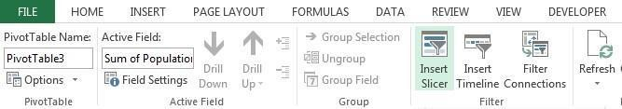


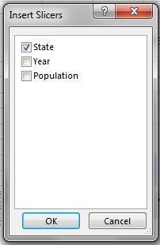


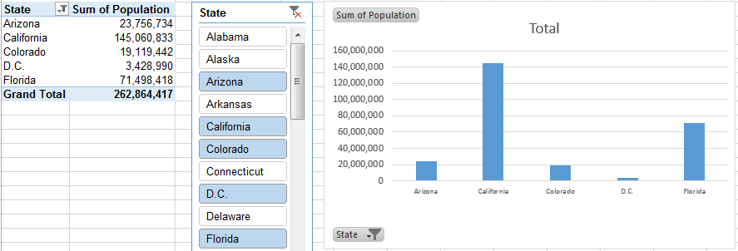

SLICERS
A Slicer is basically a “prettier” version of a PivotTable filter; it works exactly the same way by filtering the data you see in your PivotTable and PivotCharts
1) Select a PivotTable and choose “Insert Slicer” from the “PivotTable Tools” tab
2) Select the field(s) that you want to filter
3) The Slicer will be inserted next to your table, allowing you to filter on specific values (or combinations, using the CTRL key)
www.dsa.az Bütün hüquqlar qorunur.
DATA SCIENCE ACADEMY
17

Slide 18

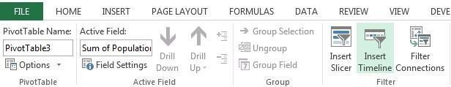


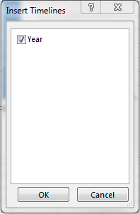


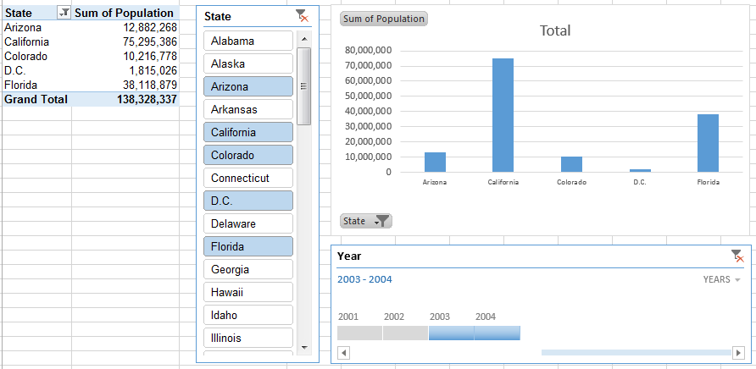

TIMELINES
A Timeline works just like a Slicer – it’s just formatted to work specifically with Date & Time fields
1) Select your pivot table and choose “Insert Timeline” from the “PivotTable Tools” tab
2) Select the date/time field(s) that you want to filter
3) The Timeline is inserted, allowing you to filter on specific time frames (Note: may need to adjust unit of time (month, year, etc.))
www.dsa.az Bütün hüquqlar qorunur.
DATA SCIENCE ACADEMY
18

Slide 19
Pivot Table: Practice
Using the IMDb PivotTable, practice creating views to show:
Budget and Revenue by Country, Genre, and Title
Revenue by Country, filtered only on Horror films
Revenue by Genre and Rating, filtered only on B&W films produced in the United States
www.dsa.az Bütün hüquqlar qorunur.
DATA SCIENCE ACADEMY
19

Slide 20
Pivot Table: Practice
How many Japanese movies in the database were produced in English?
How much gross revenue did "The Celebration" generate?
How much revenue was generated by Comedy films in Finland?
How much revenue was generated by PG-rated Family films? Which title drove most of the revenue?
What was the budget for "A Passage to India"? and change the number
format to currency, with a dollar sign and no decimal places.
Show Gross Revenue by Genre (rows) and Rating(columns).
www.dsa.az Bütün hüquqlar qorunur.
DATA SCIENCE ACADEMY
20

Slide 21
Thank you!

